Slide 1
111 Spring
DBMS Final Project
Course Selection System

Slide 2
Project Description
You are tasked to design a Course Selection System for a school. The school has already provided you with their needs and requirements. Your mission is to ensure the timely completion of this Course Selection System in order to receive payment. The information you received is as follows:

Slide 3
Definition about system Users
There are three types of users who can access the system: Student, Teacher and Visitor.
Visitor means the user didn’t login as a student or a teacher, and visitor can only search for the Courses. ref PPT p.16
Students and Teachers will be assigned a set of credentials (student ID / teacher ID and password) for accessing the system. Students and Teachers need to change their password after first login.[2]
The school has requested you to store the Students’ and Teachers’ passwords after hashing.

Slide 4
Semester and Phases of the system
For this system, each semester has three phases:
Before course selection
During course selection
After course selection
Three phases cover the entire semester and won't overlap
There are two semesters within a year, and the semester format for this school is “academic year+1(2)". For example, the second semester of the academic year 111 would be referred to as 1112
Note: For better explanation, if the present semester is 1112, "next semester" would be 1121.

Slide 5
Status of Course selection
The course selection status can only be divided into: Preliminary、Enrolled、Unselected、Withdrawn
Preliminary: student selects the course without Course Card
Enrolled: successfully enroll in the system (or with Course Card)
Unselected: fail to enroll in the system
Withdrawn: students can only whitdraw elective courses that are in the status of Preliminary or enrolled

Slide 6
Rules and limitations
Each degree program will have its corresponding required or elective courses, and once the degree program is established, the required or elective courses of each program cannot be modified [7]
The required course within each degree program has prerequisite year.
[12]
e.g.. A course within a program is a required course, and its prerequisite year is "2nd year" which means Students of 1st year are not allow to study this course in this degree program.

Slide 7
Rules and limitations
The prerequisite year of the same course within different degree program can vary[12]
Note: Only the required courses within the program have prerequisite year. Elective courses can be studied by all students.
There is a special program called "Liberal Education". All the course in this special program is elective course, and all the students will be assign to this program
Courses may have corresponding prerequisite courses, and the prerequisite courses for each course will remain the same regardless of the semester or the program[8]

Slide 8
Rules and limitations
Course Code and Course Name of the same course in different semesters or program have to be the same and unique. However, the syllabus, room, and time for the same course, may vary in different semesters.
if a course belongs to a program, its prerequisite courses should also be within the same program
Each elective course in the program has its own Course Card for every semester in which it is offered, the course card is managed by the Teacher of the Course

Slide 9
Course Regulations for Students
Students will be assigned to the corresponding Degree Program based on the major they applied for and the Liberal Education program. Students can’t pursue another Degree Program.
Students can only select the required and elective courses specified within their respective Degree Program and all the course within the Liberal Education program
Students cannot select the Course if they haven't completed the corresponding prerequisites for that course

Slide 10
Course Regulations for Students
Students can ask the Teacher of the Course for the Course Card for course selection in order to ensure they enroll successfully
In order to graduate, students must complete all the required courses and minimum of 5 elective courses within their Degree Program and minimum 3 courses within the Liberal Education program

Slide 11
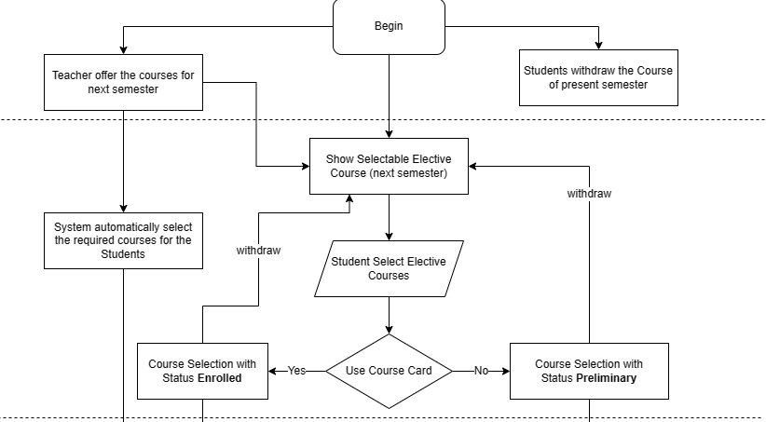
Before Course Selection
During Course Selection

Slide 12
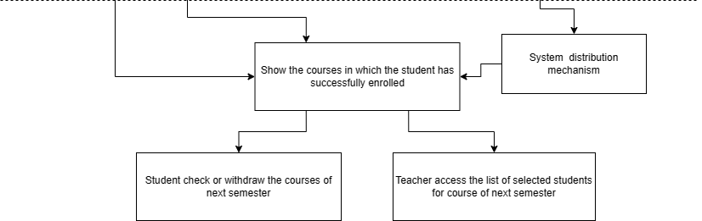
After Course Selection

Slide 13
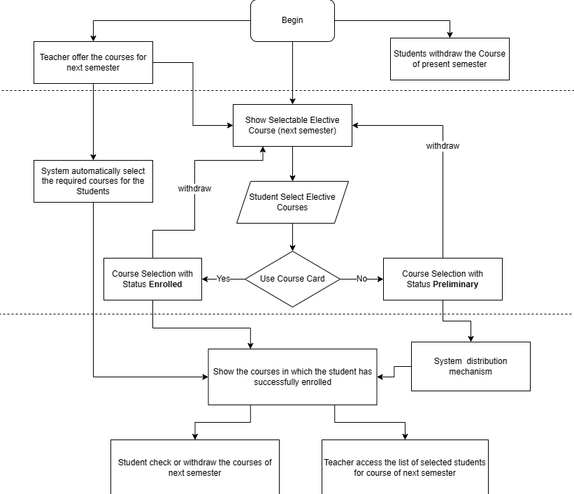

Slide 14
Scenario – Before course selection
Teachers can offer the Course for the next semester, Teachers can only offer the Course of next semester Before course selection [11]
Students can withdraw the elective Courses of present semester, Students can only withdraw the elective Course of present semester Before course selection

Slide 15
Scenario – During course selection
At the beginning of the course selection, System will automatically select the required courses for the Students based on their Degree Program and grade. Students only need to select the elective courses for the next semester. [12]
System will give students the lists of selectable course: [9]
course have to be offered at next semester
all the elective courses from the Degree Program (students pursue) and Liberal Education Program
the course that students haven’t complete (also include had had selected but fail the course)
student already complete the prerequisite courses of that course

Slide 16
Scenario – During course selection
If Students select the Course with Course Card, the status of course selection will automatically become Enrolled. Otherwise, it will be Preliminary
Students can review their Course Selection record [3], and they can withdraw the elective Course with the status of Preliminary or Enrolled
Note: If Students select the Course with the Course Card and then withdraw it, the Course Card can’t be used again

Slide 17
Scenario – After course selection
System will firstly distribute Students to the Courses with the status of Preliminary of course selection:
The system will distribute student with its own mechanism
Students with status of "Preliminary" successfully enroll in the course will change the status to “Enrolled", Otherwise, change to "Unselected"

Slide 18
Scenario – After course selection
Students can check whether they have been successfully enroll in the courses
Students can withdraw the elective Course with status of “Enrolled"[5]
Note: Because student can only select the course at During course selection phrase，so if they withdraw from the course at After course selection phrase they can only select it again the next time it is offered.
In addition, The course won't fill the vacant spot left by a student's withdrawn with another student
Teachers can access the list of enrolled students of their courses for the next semester

Slide 19
Scenario – Entire Semester
Teacher can access the list of enrolled students of their courses before the present semester (inclusive) [4]
Students can access their course selection record (within all of the status) before the present semester (inclusive)
All users can search for the Courses offered by the school before present semester (include)[6]
They need to provide the semester as a mandatory search key and can use the Course Code, Course Name, Teacher, or Degree Program as optional search keys.

Slide 20
Entities
The school stated that the basic entities of this system are as follows:
Student and Teacher: user of the system
StudentCredential and TeacherCredential: storing the student’s and teacher's hashed password
Degree Program: program for student to pursue
Course: teachers offer the course for students to take
Coursecard: students can use a course card for course selection to ensure successful enrollment

Slide 21
Business logics
A student or teacher can only have one credential (student ID / teacher ID and password)
A student can only pursue one Degree Program with a Liberal Education Program
A course can belong to multiple programs, each program can have multiple courses(required or elective)
Note: Liberal Education Program only have elective program
A course can have multiple teachers teaching together, and the teachers for the same course in different semesters may vary.

Slide 22
Business logics
If student select and complete the Course, system needs to note that students already complete the Course, in order to distinguish whether the prerequisite courses have complete
If student select the Course with Course Card, the system must note the Course Card has been used can’t be used agian [10]

